Slide 1
General Domain Adaptation Through Proportional Progressive Pseudo Labeling
Mohammad Hashemi, Eric Keller
University of Colorado Boulder
IEEE BigData 2020
Notes:
Hi everyone. My name is Mohammad Hashemi from the University of Colorado Boulder and today I want to present our paper general domain adaptation through proportional progressive pseudo labeling.

Slide 2
Deep Neural Networks
Used for many different tasks.
Object recognition
Sentiment analysis
Anomaly detection
Need to be trained on very large labeled datasets.
Data labeling is expensive, time-consuming and needs a human in the loop.
For some tasks such as anomaly detection in network traffic, we can’t label everything in advance.
Because of zero-day attacks
Notes:
So we know that, deep neural networks have been used to approach many different tasks such as object recognition, sentiment analysis, and anomaly detection.
But in order to get very good results, we need to train them on very large labeled datasets.
The problem is that labeling a huge dataset is expensive, time-consuming, and needs a human in the loop.
In addition, we can’t always label everything in advance. Like when we want to detect zero-day attacks in network traffic.

Slide 3


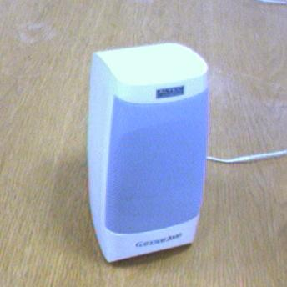








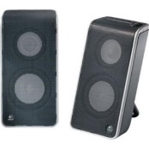
Domain Shift Problem
Office-31
Potential solution
Train the model on a similar dataset that is already labeled.
Can’t get good results when there is a domain gap.
Acc:79%
Slowloris SlowHTTPTest Hulk
SSH-Patator FTP-Patator
CICIDS-2017
F1: 0.028
Notes:
One potential solution to this issue is to train the model on a dataset similar to the target dataset that is already labeled.
But such a model doesn’t work well enough on the target dataset if the labeled dataset and target dataset are not coming from the same distribution and when there is a domain gap between them.
For example, we trained a model on the left images to classify images shown on the right side
And we trained another model on a network traffic containing network attacks shown on the left box to detect some other attacks shown on the right box
But as you can see, the results are not very good because of the domain shift between the source and the target domains and there is still some space for improvement.

Slide 4
Unsupervised Domain Adaptation
Mitigate the domain shift Between a labeled source domain and an unlabeled target domain.
✓
Many DA methods have been proposed.
CAN [Kang et al. CVPR `19]
CDAN [Long et al. Neurips `18]
79%
CAN
94%
Slowloris SlowHTTPTest Hulk
SSH-Patator FTP-Patator
Can’t generalize well across different input types!
✗
0.028
CAN
0.123
Notes:
Unsupervised domain adaptation methods are used to address such problems to
mitigate the domain shift between a labeled source domain and an unlabeled target domain.
Recently, many different domain adaptation methods have been proposed like CAN and CDAN.
These methods work well when they are applied to the image inputs.
For example, on the image dataset we just mentioned after doing domain adaptation with the CAN approach model accuracy increases to 94% from 79%.
But the benefit of these methods is very limited when we apply them to other input types such as text or network traffic.
For example, on the anomaly detection task, we mentioned CAN could only increase the F1 score to 0.1.
Therefore, existing domain adaptation methods can’t generalize well across different input types.

Slide 5
How to build a more general domain adaptation method that can be applied to several different input types?
Notes:
So in the rest of this presentation, we want to see how we can build a more general domain adaptation method that can be applied to several different input types, such as images, text, and network traffic.

Slide 6
Solution in a nutshell
Assign pseudo-labels to the target domain samples directly based on model predictions and train the model with them.
Exclude samples with more likely wrong pseudo-labels from the training set.
Postpone training on such samples.
We assume that we know the “Class Proportions” in the target domain.
Notes:
in a nutshell, we want to assign pseudo-labels to the target domain samples directly based on the model predictions and train the model with them
While excluding samples with more likely wrong pseudo-labels from the train set
Or postponing training on such samples.
For this purpose, we assume that we can guess the proportion of target domain samples that belongs to each class. At the end of this presentation, we show how sensitive our approach is to the accuracy of this guess.

Slide 7
Insight 1 – MSE is a better choice when training with pseudo-labels
Cross Entropy
Mean Square Error
No one-to-one mapping between the outputs of the Softmax layer and the logits!
✓
Target sample with pseudo-label C
Target sample with pseudo-label C
Mitigates the domain gap between the source and the target samples at logit space!
Source sample with label C
Source sample with label C
Logit space
Probability space
Logit space
Notes:
Before getting into the details of our method we want to first provide some insights that helped us to design it. The first insight is about the loss function we use to train the model. After assigning pseudo-labels to the target domain samples, there are two ways to train the model.
We can add a Softmax layer to the model and train it with the cross-entropy loss,
or we can minimize the distance of the final layer of the network and the one-hot encodings of pseudo-labels with the help of the mean square error.
We argue here that for such a setting mean square error is a better choice.
The problem with the cross-entropy loss is that there is no one-to-one mapping between the outputs of the softmax layer and the logits.
This means that the points that belong to the same class can build multiple clusters.
More specifically, the source samples and target samples that have the same label might fall into multiple clusters.
On the other hand, when we use MSE, all the points that have the same label fall into one cluster.
This characteristic is more desirable as it mitigates the domain gap between the source and the target samples at logit space.

Slide 8
Insight 2 – training only on correct samples gradually reduces the target error
Classified as blue!
?
Assign pseudo-labels to the target domain samples
Correct
Wrong
Correct
Wrong
Exclude wrong samples
Progressively reduce the target error!
Correct
Train on correct samples
Classified as red!
Notes:
The second insight is that when we only train a model on correct target domain samples it gradually reduces the target error. So suppose that we have a model pre-trained on the source domain.
Also, suppose that we have 3 target domain samples from one class that fall in close proximity of each other at some middle representation of the network. Suppose that the model predicts one of them correctly and the other ones are predicted incorrectly.
When we only train the model on the correct samples, then the model learns that the points in close proximity of these points are also more likely to be from the same class
and potentially some of them will get a correct pseudo-label in the next iteration.
This effect gets propagated to the other close points in the next iterations.
Therefore, after assigning pseudo-labels to the target domain samples based on model predictions, excluding wrong samples, and training only on correct samples we can progressively reduce the target error. Using this technique we could get results better than any other existing work for many different domain adaptation tasks.
But the problem is that there is no straightforward way to determine which predictions are wrong to exclude them from the training procedure as we don’t know the target domain labels. But as we show in the next insight we can define an uncertainty metric to help us determine which cases are more likely to be wrong.

Slide 9
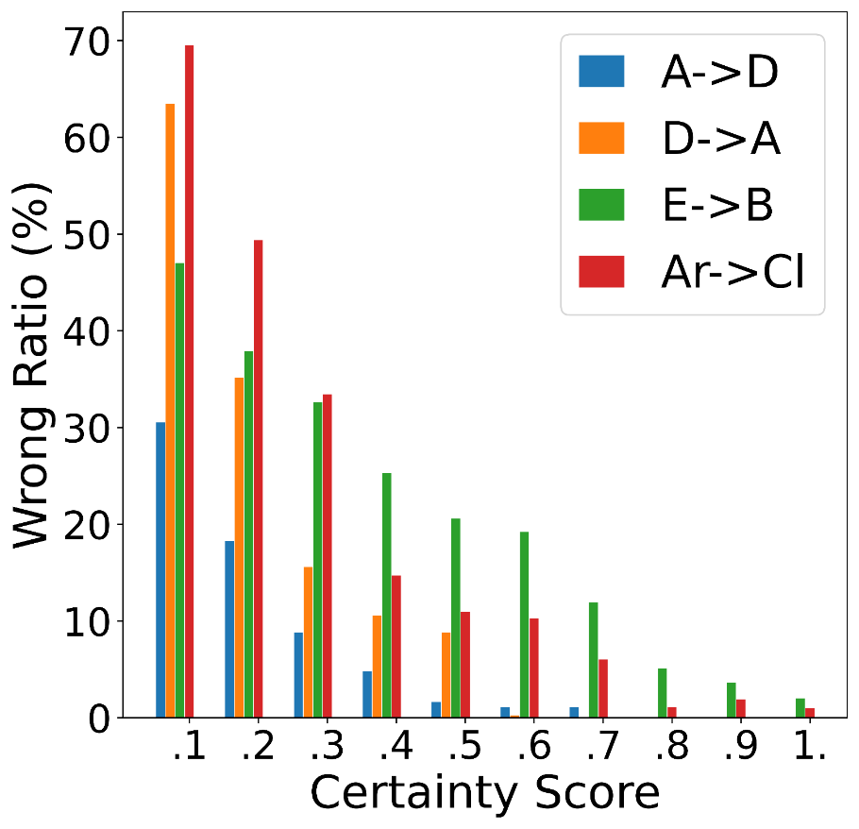

Insight 3 – an uncertainty metric can guide which predictions are wrong
$Certainty Score=$
$$Largest Score −Second Largest Score$$
Among the samples with the same pseudo-label, there is a relation between this certainty score and the chance of being predicted wrongly.
Smaller certainty score Higher chance of a wrong prediction
Notes:
So we define the certainty score as the difference between the two largest scores that the model outputs for each sample.
Among the samples with the same pseudo-label, there is a relation between this certainty score and the chance of being predicted wrongly.
When the certainty score decreases, the two largest scores that the model outputs get closer to each other, which means that the model is less certain about its prediction which means that it’s more likely to be a wrong prediction.
This relation can also be seen in this graph. In this graph, the x-axis shows the certainty score and the y-axis shows the percentage of the target samples that are predicted wrongly and have the same pseudo-label. We showed these ratios for 4 different domain adaptation tasks. As you can see, when the certainty score decreases the wrong ratio increases for all of the tasks. Using this certainty score, we can determine which cases are more likely to be wrong, but we can’t be 100% sure about them, and therefore it might be inevitable to assign some wrong pseudo-labels to some of the target samples and train the model on them.

Slide 10
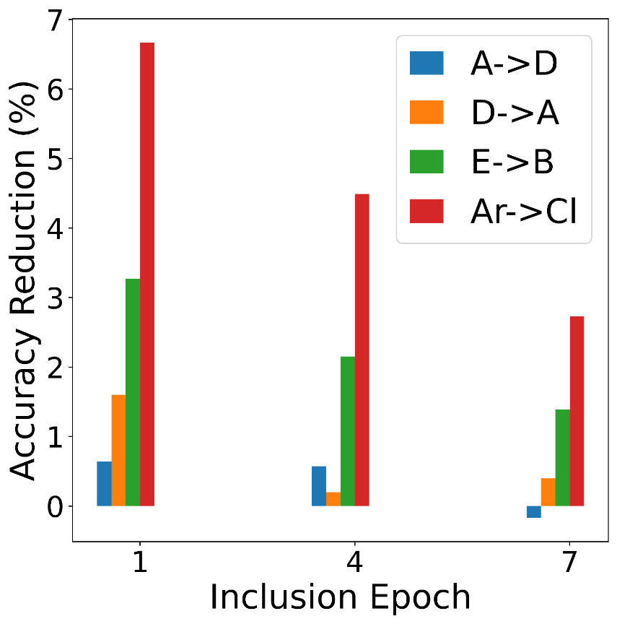
Insight 4 – the timing of inclusion of a wrong-prediction matters
Early inclusion of wrong samples into the training procedure deteriorates the model's performance on the target domain more than later inclusion.
Because of the same propagation phenomenon, we explained for insight 2.
7% reduction in final accuracy when the wrong samples were included in the first epoch compared to when they were included in the last epoch.
Trained each model for 10 epochs.
Notes:
This brings us to the last insight we want to discuss which is about the timing of inclusion of wrong predictions.
We argue that early inclusion of wrong samples into the training procedure deteriorates the model's performance on the target domain more than later inclusion.
And this is because of the same propagation phenomenon we explained for insight 2.
This can also be seen in this graph.
For this graph, we trained a model for 10 epochs on the correct target domain samples for 4 different domain adaptation tasks And in each case, we also included some wrong samples into the training procedure at different epochs. The x-axis shows the epoch we included the wrong samples and the y-axis shows how much accuracy decreases compared to when we include the wrong samples at the final epoch.
As you can see, the earlier the model gets trained on the wrong samples the more its accuracy decreases.

Slide 11
Proportional Progressive Pseudo Labeling
Train the model on the source domain.
Target domain samples
In each iteration of PPPL:
Feed all the target domain samples to the model.
Assign a pseudo-label to each of them based on the largest score the model outputs.
Group target domain samples based on their pseudo-labels, calculate the certainty score for each sample.
Model
exclude wrong predictions, or delay training on such samples or reduce their impact on the model parameters.
Less certain
More certain
…
Notes:
So, Based on the insights we talked about, we designed our method:
we first train the model on the source domain samples. Then in each iteration of our algorithm, we do the following steps:
We feed all of the target domain samples to the model.
And then we assign a pseudo-label to each of them which is the class index of the largest score the model outputs for each one.
Then, as we discussed, we want to exclude wrong predictions, or delay training on such samples, or reduce their impact on the model parameters:
So, we group the target domain samples based on their pseudo-labels and
Then we calculate the certainty score for each sample.

Slide 12
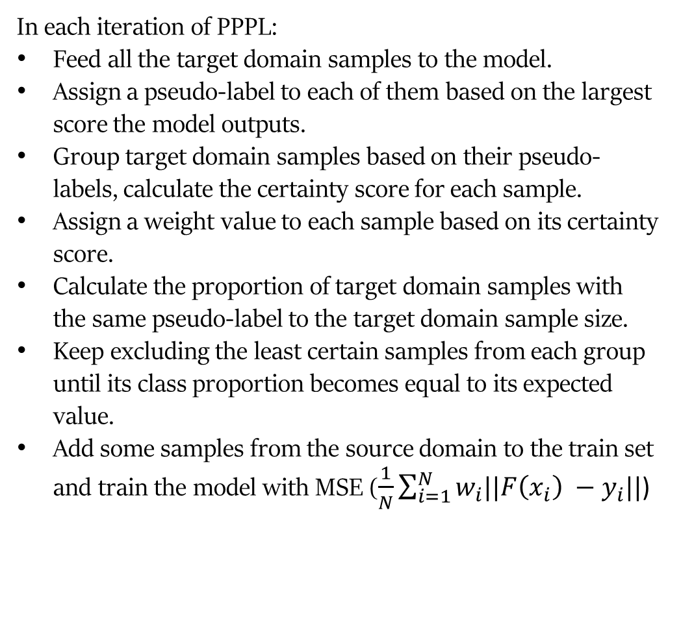
Proportional Progressive Pseudo Labeling
Train the model on the source domain.
Target domain samples
In each iteration of PPPL:
Feed all the target domain samples to the model.
Assign a pseudo-label to each of them based on the largest score the model outputs.
Group target domain samples based on their pseudo-labels, calculate the certainty score for each sample.
Assign a weight value to each sample based on its certainty score.
Calculate the proportion of target domain samples with the same pseudo-label to the target domain sample size.
Keep excluding the least certain samples from each group until its class proportion becomes equal to its expected value.
Add some samples from the source domain to the train set and train the model with MSE ($\frac{1}{N}\sum_{i=1}^{N}{w_{i}||F\left(x_{i}\right) −y_{i}||}$)
Model
exclude wrong predictions, or delay training on such samples or reduce their impact on the model parameters.
Less certain
More certain
…
W
0
[0.2 – 1]
Notes:
Then we want to assign a weight value to each sample to control its effect on the model parameters based on its certainty score.
In the first iteration, we assign a weight of zero to 90% of the samples that are least certain and a weight between .2 and 1 to the others. For the next iterations, we progressively, increase the size of samples with a weight greater than zero by 2% in each iteration. By doing so, we essentially postpone training the model on samples that are more likely to be wrong. Also for the ones which will be included in the training set their impact would be proportional to their chance of being predicted correctly. There is also another way we try to exclude wrong samples which is based on the guessed class proportions that we mentioned earlier.
So we first, calculate the proportion of target domain samples with the same pseudo-label to the target domain sample size for all the classes.
Then, from each group with a class proportion larger than its expected value, we keep excluding the most uncertain predictions until the ratio of remaining samples becomes equal to our expected ratio. Because those samples also have a high chance to be wrong.
In the end, we select some random samples from the source domain and add them to the train set with a weight equal to 1 and train the model with MSE loss function on all of them.

Slide 13
EVALUATION
Notes:
Finally to see how our method actually improves the accuracy on the target domain we evaluated it on several different datasets.

Slide 14
Results
Network Traffic
Time-series
62% improvement
19% improvement
Notes:
This graph shows how our method performs on the CICIDS and Yahoo datasets compared to the other baselines. The task in these two datasets is to detect anomalies.
As you can see
on the CICIDS dataset we are 62% better,
and on the Yahoo dataset, we are 19% better than the best baseline.

Slide 15
Results
Text
Image
5% improvement
Notes:
This graph also shows how our method performs compared to other baselines on the MDS, Office-31, and Office-Home datasets.
As You can see, on the MDS dataset we are 5% better than the best baseline.
And on the image datasets we can get results as good as the best baseline.

Slide 16
Sensitivity Analysis
Notes:
Finally, this graph shows how sensitive our method is to the accuracy of the guessed class proportions. In this graph for 3 different tasks of the Office-31 dataset, we reported the accuracy of our method when there is no error, and when there are 10%, 20%, and 30% error in our guessed values compared to the real target domain class proportions. The right-most column of each group also shows what we can get without doing any domain adaptation.
As you can see in all the cases even when there is a 30% error in the guessed class proportions our method still improves the model performance compared to the case where we only train the model on the source domain samples.

Slide 17
Conclusion
PPPL generalizes better than other domain adaptation methods across different input types.
Can get comparable results with the existing work on image classification tasks.
Outperforms them on other tasks with up to 62% improvement for anomaly detection in network traffic based on the F1 score.
Notes:
So in conclusion, Proportional progressive pseudo labeling generalizes better than the other domain adaptation methods across different input types.
Using this technique we can get comparable results with the existing work on many image classification tasks
While significantly outperforming them on other tasks with up to 62% improvement for anomaly detection in network traffic.

Slide 18
Questions?
Notes:
And that’s it so let me know if you have any questions.

